Slide 1
APOLOGETICS
IN ONE LESSON
almost
Ai1L.net
Lesson 7
The Primacy of the Primary Sources

Slide 2
Key Takeaways (review)
1
Events are likely to be remembered if they are: 1. Consequential
2. Vivid
3. Emotional
4. Unique 5. Rehearsed
2
The Gospel accounts include many of these events would be memorable
3
Known memory limitations cannot adequately provide an alternate explanation

Slide 3


Slide 4
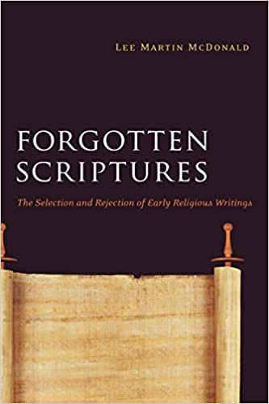

Slide 5
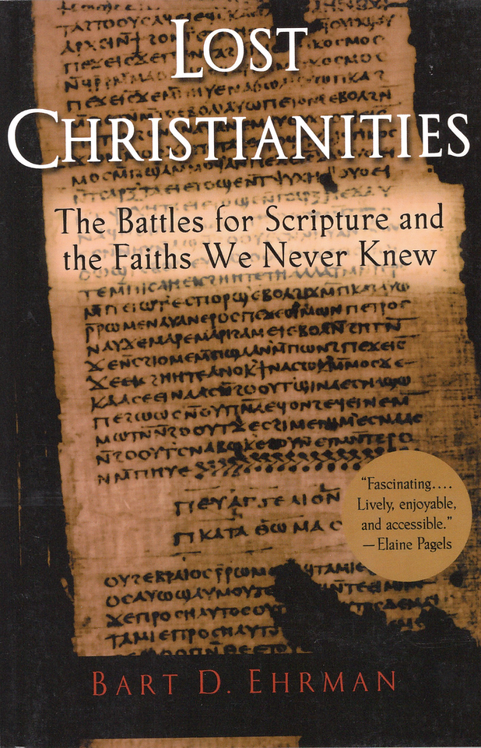

Slide 6
IDEA IN BRIEF
What?
Understand the reasons that we can believe that the 27 New Testament books are the right books
Why?
In order to show that other apocryphal works ought not to be considered comparable
How?
By knowing that the New Testament writings:
Are the earliest Christian writings
Are Apostolic
Were not chosen at. Council
Are self-authenticating

Slide 7
Write down some observations regarding the following verses regarding Jesus’ authority
1

Slide 8
Write down some observations regarding the following verses regarding the Apostles’ authority
2

Slide 9
Write down some observations regarding the authority of the Apostles’ writing
3

Slide 10
Jesus
Apostles
*
Apostles’ writing
*
By apostles, I mean anyone Jesus specifically commissioned (principally, the Twelve)

Slide 11
Why the 27 Books of the New Testament?
1
New Testament documents are the earliest Christian writings we have
2
New Testament documents are Apostolic
3
New Testament documents were not chosen at a council (i.e. Nicea)
4
New Testament documents are self-authenticating

Slide 12
Why the 27 Books of the New Testament?
1
New Testament documents are the earliest Christian writings we have
All of the apocryphal “Gospels” are second century or later (too late to be eyewitness testimony)
Only one Christian document from the first century isn’t in the New Testament is 1st Clement (96 A.D.)

Slide 13
New Testament Timeline
Revelation
Paul’s Epistles
Jesus’ Life
Gospels recorded
1st Clement
0 AD
50 AD
100 AD
Gospels as oral history

Slide 14
Why the 27 Books of the New Testament?
2
New Testament documents are Apostolic
The documents were understood to be connected to the Apostles
The authors of the Gospels are consistent and early (and don’t make sense to be made up)
The authors claimed to be writing scripture

Slide 15
Why the 27 Books of the New Testament?
3
New Testament were not chosen at a council (i.e. Nicea)
The 4 gospels are well established by the end of the second century
At end of 2nd century, Muratorian fragment lists 22 of 27 books
Early Christians used non-canonical writings, but not as the same as the NT docs as evidenced by: 1. The way they cited them (not as scripture) 2. How often they cited them (much less)

Slide 16
Clement of Alexandria Citations
Frequency of citations of canonical and non-canonical Gospels
Notes:
See http://www.ntcanon.org/Clement.shtml and https://www.thegospelcoalition.org/article/apocrypha-and-canon-in-early-christianity/

Slide 17
Matthew & John
“drawn up by His apostles and those who followed him”
Mark & Luke
Justin Martyr (150 A.D.) Dialogue with Trypho, 103

Slide 18
“It is not possible that the gospels can be either more or fewer than the number they are”
IRENAEUS OF LYONS (180 A.D.) Against Heresies (Book III, Chapter 11)

Slide 19
“For, since there are four zones of the world in which we live and four principle winds… [and] the cherubim, too, were four-faced.”
IRENAEUS OF LYONS (180 A.D.) Against Heresies (Book III, Chapter 11)

Slide 20
Most Common Books
In early canons and collections

Slide 21
Why the 27 Books of the New Testament?
4
New Testament documents are self-authenticating
See other lessons: undesigned coincidences (lessons 12 & 13), fulfilled prophecy (lesson 17), wisdom (lesson 16)

Slide 22
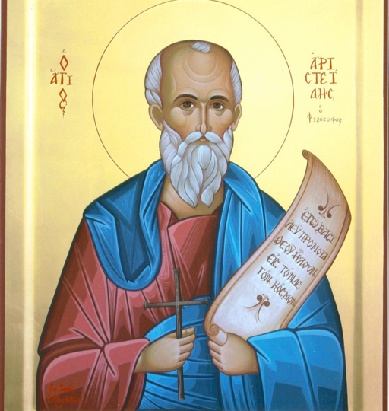
“I was led to put faith in these [Scriptures] by the
unpretending cast of the language,
the inartificial character of the writers,
the foreknowledge displayed of future events,
the excellent quality of the precepts”
TATIAN (120-180 A.D.) Oratio ad Graecos, 29

Slide 23
“I was led to put faith in these [Scriptures] by the 1. unpretending cast of the language, 2. the inartificial character of the writers, 3. the foreknowledge displayed of future events, 4. the excellent quality of the precepts”
Tatian Oratio ad Graecos, 29

Slide 24
Key Takeaways
1
New Testament documents are the earliest Christian writings we have
2
New Testament documents are Apostolic
3
New Testament documents were not chosen at a council (i.e. Nicea)
4
New Testament documents are self-authenticating

